Slide 1
Banking Application using Java
Guided By-Sandip Sir
Author-Samruddhi Pisal(194867)

Slide 2

Objective
create a bank project where you can store the customer details. Give the option to 1)deposit money 2)withdraw money 3)check the balance and display the final balance
display the list of customers of the bank with the final balance. use case and switch , collection to store the customer details and transaction details. * minimum balance should Rs1000

Slide 3
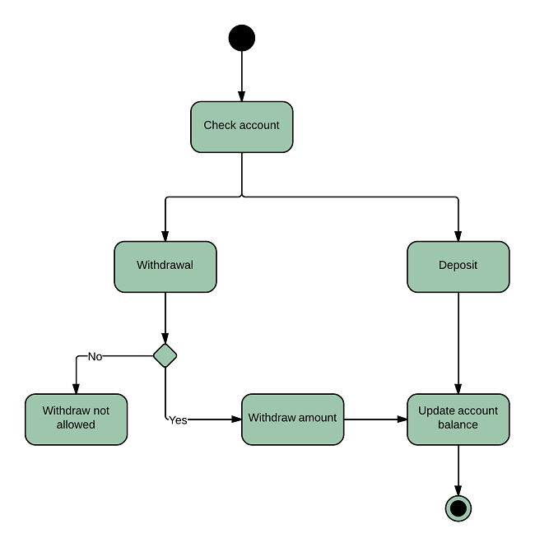
Flowchart:

Slide 4
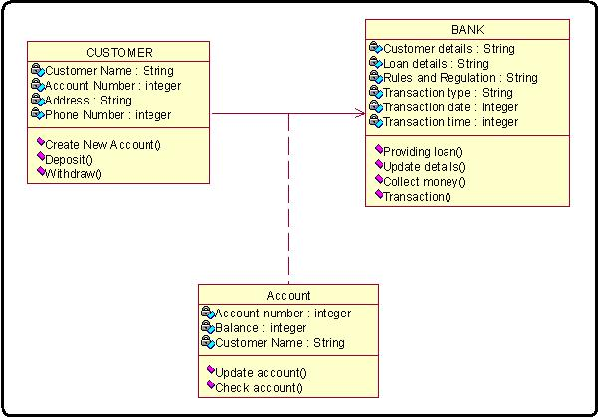
Class Diagram

Slide 5
Approach to each Option
A. Withdraw:
Take the amount user desires to
withdraw as input.
If the balance amount greater than or
equal to the withdrawal amount then Perform the transaction and give the user the desired
amount.
Else print Insufficient Funds message.

Slide 6
Continued..
B. Deposit:
Take the amount user desires to deposit as input.
Add the received input from the user to balance and update its value.
balance = balance + deposit.
Print a message on screen stating deposit transaction has been successful.

Slide 7
. Check Balance:
Print a message on screen showing the
value of balance amount.
D. Exit:

Slide 8
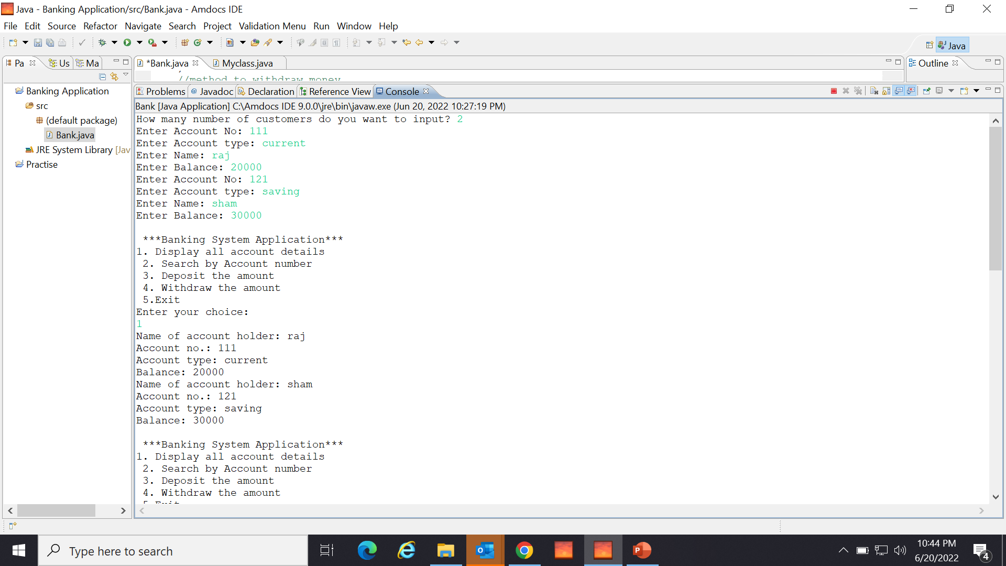
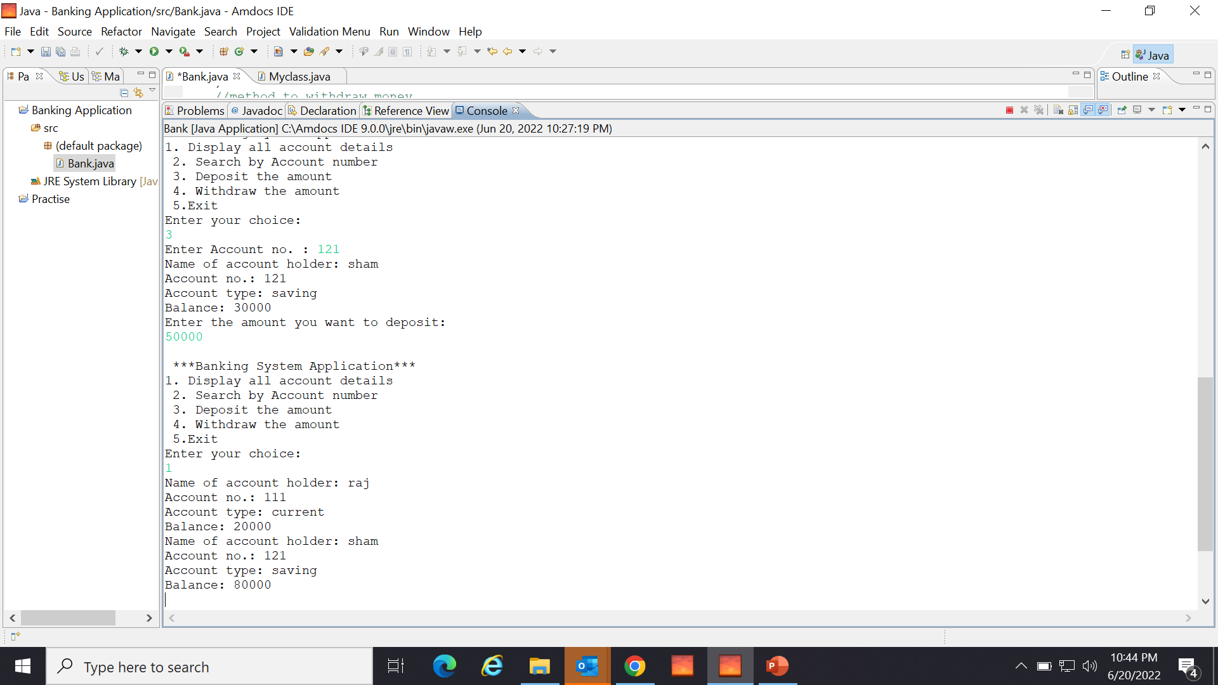
Code

Slide 10
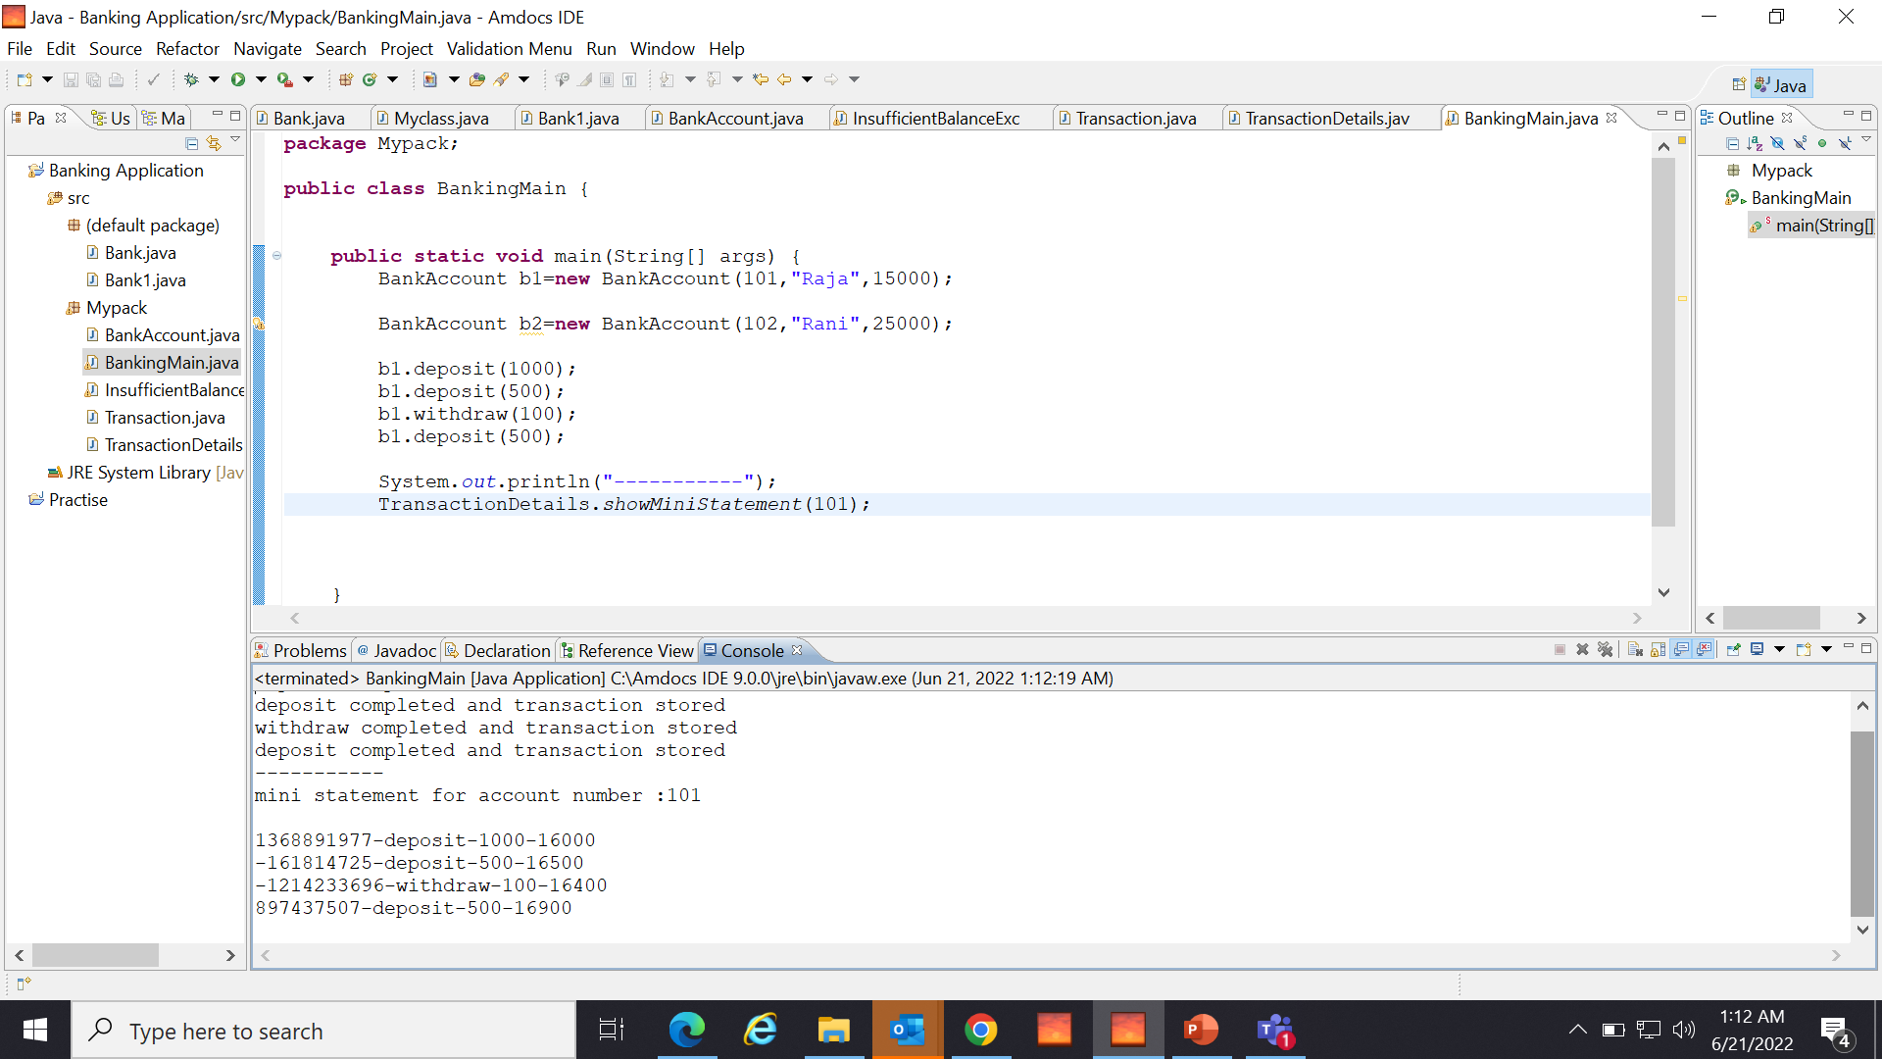
Code using Collection Framework-list and likedlist

Slide 11
Thank You!!

